Slide 1
Slide 4
Imperative Programming: Loop
Dasar-Dasar Pemrograman 1
Semester Ganjil 2016/2017

Slide 2
Repetition statements
Beside selecting which statements to execute, a fundamental need in a program is repetition
  Repeat a set of statements under some conditions
With both selection and repetition, we have the two most necessary programming statements
Dasar-Dasar Pemrograman Ganjil 2016-2017

Slide 3
While and For statements
The while statement is the more general repetition construct. It repeats a set of statements while some condition is True.
The for statement is useful for iteration, moving through all the elements of data structure one at a time.
Dasar-Dasar Pemrograman Ganjil 2016-2017

Slide 4
while loop
Top-tested loop (pretest)
  Test the boolean expression before running
  Test the boolean expression before each iteration of the loop
while <boolean expression>:
<body>
Dasar-Dasar Pemrograman Ganjil 2016-2017

Slide 5
while loop
A while statement executes a block of code repeatedly
A condition controls how many times the loop is executed
while <condition>:
<statement>
It means:
  Evaluate the condition
  If the condition is true, execute statement and then go to step 1 again; if the condition is false, the loop is finished
Dasar-Dasar Pemrograman Ganjil 2016-2017

Slide 6
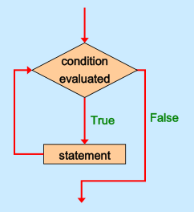
Logic of a while Loop
Dasar-Dasar Pemrograman Ganjil 2016-2017

Slide 7

Example
Output:
  5 4 3 2 1
Dasar-Dasar Pemrograman Ganjil 2016-2017

Slide 8
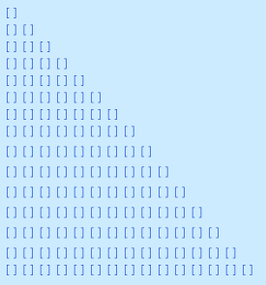
Exercise
Write a while statement to print the following:
Dasar-Dasar Pemrograman Ganjil 2016-2017

Slide 9
Exercise
Write a program that keep asking the user to enter a positive value < 100 until the user provides a correct input!
Dasar-Dasar Pemrograman Ganjil 2016-2017

Slide 10
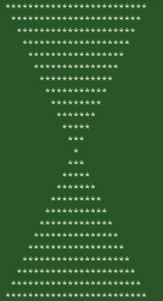
Exercise
Write a while statement to print the following:
Dasar-Dasar Pemrograman Ganjil 2016-2017

Slide 11

While loop with else
While loop can have an associated else block
Else block is executed when the loop finishes under normal conditions (i.e., without hitting a break)
  Basically the last thing the loop does as it exits
Dasar-Dasar Pemrograman Ganjil 2016-2017

Slide 12
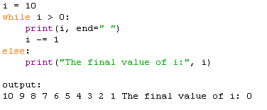
Example
Dasar-Dasar Pemrograman Ganjil 2016-2017

Slide 13
Range function
The range function represents a sequence of integers
The range function takes 3 arguments:
  The beginning of the range. Assumed to be 0 if not provided
  The end of the range, but not inclusive (up to but not including the number)
  The step of the range. Assumed to be 1 if not provided
If only one argument provided, assumed to be the end value
Dasar-Dasar Pemrograman Ganjil 2016-2017

Slide 14
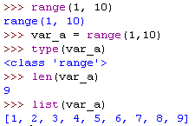
Range generates on demand
Range generates its value on demand
Dasar-Dasar Pemrograman Ganjil 2016-2017

Slide 15
Iterable
A data type that is iterable means that the individual elements can be “iterated through” using a for loop (or other methods)
A string is indeed an iterable data type, and you can iterate through the individual elements of a string using a for loop
Dasar-Dasar Pemrograman Ganjil 2016-2017

Slide 16
for loop
Executes a block of code for every item of a sequence
  If sequence is a string, items are its characters (single-character strings)
for <variable> in <sequence>:
<indented code block >
<non-indented code block>
Dasar-Dasar Pemrograman Ganjil 2016-2017

Slide 17
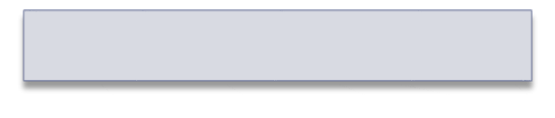



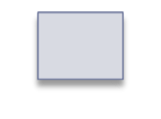

for loop
Executes a block of code for every item of a sequence
  If sequence is a string, items are its characters (single-character strings)
  name=
  char=
  char=
  char=
  char=
  char=
'A p p l e'
>>> name = 'Apple'
>>> for char in name:
print(char)
A
p
p
l
'A'
'p'
'p'
'l'
'e'
Dasar-Dasar Pemrograman Ganjil 2016-2017

Slide 18



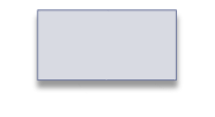
Example
word =
word =
word =
word =
'stop'
'desktop'
'post'
'top'
for word in ['stop', 'desktop', 'post', 'top']:
if 'top' in word:
print(word)
print('Done.')
>>>
stop
desktop
top
Done.
Dasar-Dasar Pemrograman Ganjil 2016-2017

Slide 19
Exercise
Write a “spelling” program that:
Requests a word from the user
Prints the characters in the word from left to right, one per line
Dasar-Dasar Pemrograman Ganjil 2016-2017

Slide 20
Write for loops with range function that will print the following sequences:
0, 1, 2, 3, 4, 5, 6, 7, 8 , 9, 10
1, 2, 3, 4, 5, 6, 7, 8, 9
0, 2, 4, 6, 8
1, 3, 5, 7, 9
20, 30, 40, 50, 60
Dasar-Dasar Pemrograman Ganjil 2016-2017

Slide 21
break statement
A break statement in a loop, if executed, exits the loop
It jumps out of the closest enclosing loop
It exits immediately, skipping whatever remains of the loop as well as the lese statement (if it exists) of the loop
Dasar-Dasar Pemrograman Ganjil 2016-2017

Slide 22
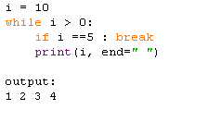
Example
Dasar-Dasar Pemrograman Ganjil 2016-2017

Slide 23
continue statement
A continue statement means to immediately jump back to the top of the closest enclosing loop and re-evaluate the condition
Any remaining parts of the loop are skipping for the one iteration when the continue was executed
Dasar-Dasar Pemrograman Ganjil 2016-2017

Slide 24
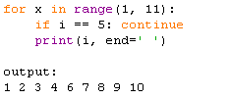
Example
Dasar-Dasar Pemrograman Ganjil 2016-2017

Slide 25
pass
The statement pass does nothing at all: it’s an empty statement
It is used when the syntax requires a statement, but we have nothing useful to say
Dasar-Dasar Pemrograman Ganjil 2016-2017

Slide 26
References
William Punch & Richard Enbody. The Practice of Computing using Python, 2nd Edition. Addison-Wesley, 2013
Y. Daniel Liang. Introduction to Programming Using Python. Prentice Hall, 2013.
John Zelle. Python Programming: An Introduction to Computer Science, 2nd Edition. Franklin, Beedle & Associates Inc., 2010.
Mark Lutz. Learning Python, 5th Edition. O’Reilly Media. Copyright 2013 Mark Lutz, 978-1-44-93-5573-9
L. Y. Stefanus. Slide Pelatihan Python. 2015.
Dasar-Dasar Pemrograman Ganjil 2016-2017

